Slide 1
Learning Management System (LMS)

Slide 2
LMS Introduction
Learning platform for educators and learners
Web based system
Open source Software (Moodle)
E-Learning
Customized software from HEC

Slide 3
LMS Features
Course Content Sharing
Online Assignments
Online Quiz
Online Results
Online Attendance
Online Discussion Forum
Blogs etc.

Slide 4
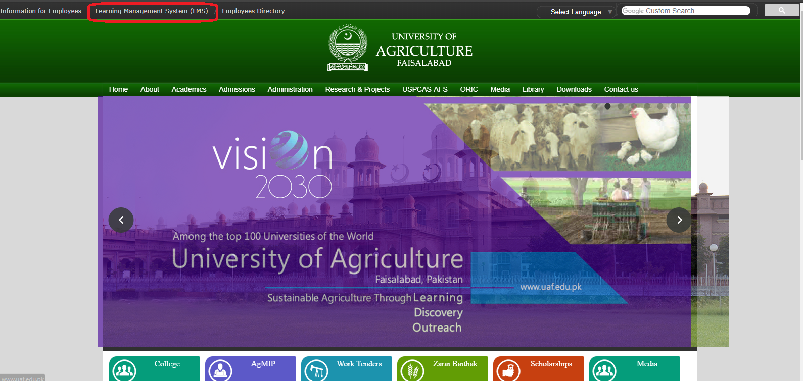
Access LMS
1. Open Directly from Browser
Lms.uaf.edu.pk
2. Link is also given on top of the UAF main website.

Slide 5
LMS Role
There are four level of roles in LMS.
Admin
LMS Manager
Teacher
Student
Here we discuss only last three role

Slide 6
Role in LMS
LMS Manager:
Every department has more than one LMS manager who can create courses for their fellow Teachers as well.
LMS manager also assign role to teacher in their relevant course
Teacher:
Teacher can upload Course Contents, Attendance, result, assignment, quiz and other course material.
Teacher make groups for making award list on LMS and submit results to controller.

Slide 7
Role in LMS
Student:
Student can check their Result online.
Student can attempt their quiz and submit their assignments
Student can submit their evaluation for teacher and course.

Slide 8
Result Submission Work Flow
Course Creation
Upload Result
Submit to Controller
Class Formation
Group Creation
Upload Course Content

Slide 9
For Help and assistance
Contact #: 041-9200161
Ext : 3315
Email: lms@uaf.edu.pk,

